Slide 1
Video Content Creation using Midjourney

Slide 2
Prerequisite for the session
Register to Discord.
Login to Midjourney
Try some prompt to check.

Slide 3
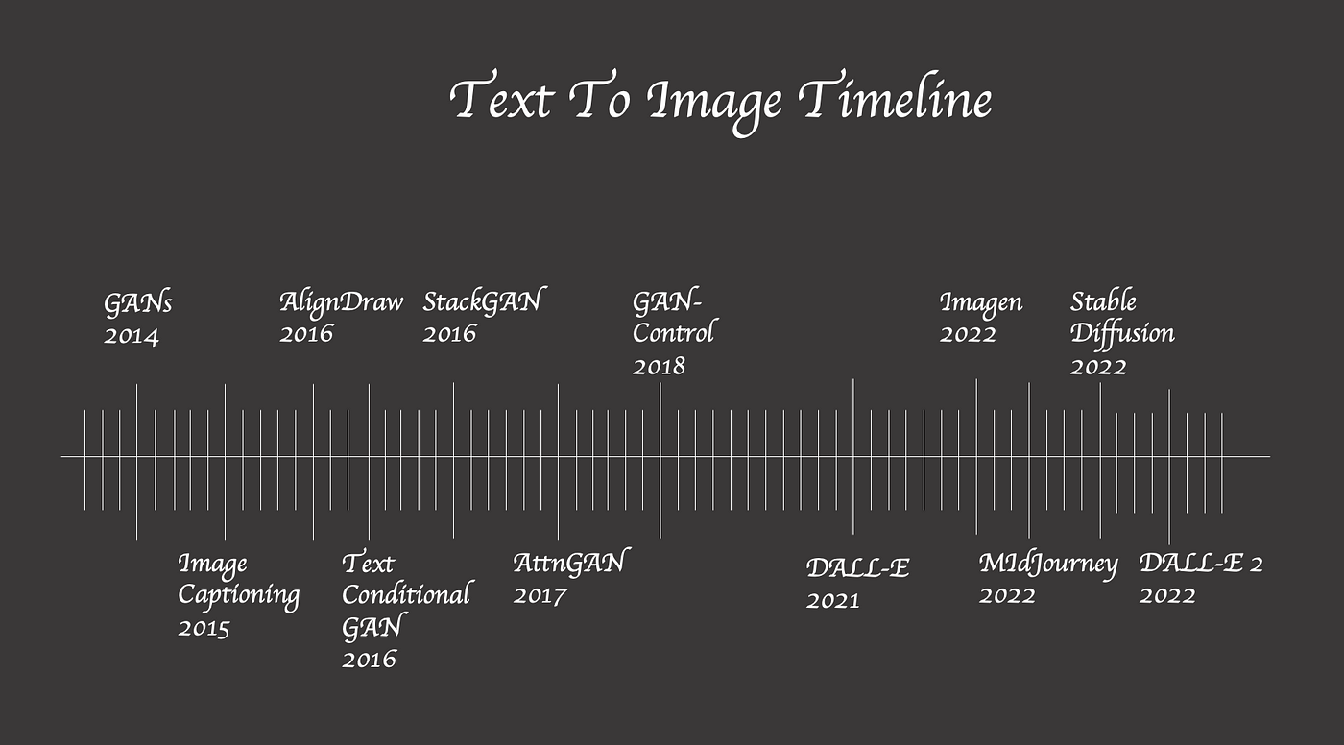
Evolution of text to image generation from GAN

Slide 4
Evolution of text to video generation in CPU
Era | Model Type | Notable Models | CPU Feasibility | Notes on Computation
2017–2019 | GAN (Generative Adversarial Network) | MoCoGAN, TGANs-C | Feasible (small scale) | Early models could be trained/tested on CPUs, but with long runtimes and limited resolution
2020–2021 | Hybrid (GAN + VAE/Transformer) | StoryGAN, TGANs, Phenaki | Very Limited | Increasing video length and complexity made GPU training nearly essential for reasonable times
2022–2023 | Transformers, Larger VAEs | VideoGPT, NUWA | Impractical | Transformers with many parameters make CPU use only viable for trivial demos, not full-scale models
2023–Present | Diffusion Models, 3D U-Net, Hierarchical | Make-A-Video, Imagen Video, Stable Video Diffusion | Not Feasible | State-of-the-art models require massive parallel computation. Training or inference on CPU is orders of magnitude slower—even small experiments are barely practical

Slide 5
Evolution of Diffusion models
The Beginning Aug 2022 — v1.4
First public release by Stability AI + CompVis + LAION
512×512 images, LAION-2B dataset
Could run on consumer GPUs
Aug 2022 — v1.5
Fine-tuned v1.4 for better quality & prompt understanding
Late 2022
Community fine-tunes explode (anime, realism, styles)
AUTOMATIC1111 Web UI becomes popular

Slide 6
Evolution of Diffusion models
Big Upgrades Feb 2023 — v2.0
768×768 native resolution
OpenCLIP text encoder
Added negative prompts
Feb 2023 — v2.1
Improved style diversity & detail
Apr 2023 — SDXL Beta
1024×1024 resolution, better realism
Jul 2023 — SDXL 1.0
Two-stage pipeline: base + refiner
Sept 2023 — SDXL Turbo
1-step / 4-step ultra-fast generation

Slide 7
Evolution of artificial image and video generation models
Dramatic Improvement in Visual Realism
AI models like Midjourney have rapidly advanced, generating images and videos that are nearly indistinguishable from those created by human artists.
Enhanced detail, texture, and consistency are now possible even from simple text prompts, supporting professional creative workflows.

Slide 8
Image and video generation models a comparison
Mid journey excels in creating highly artistic and visually rich images, often with unique styles, intricate details, and creative interpretations.
Video models can capture motion and temporal dynamics but may currently lag behind image models in fine detail and artistic nuance.
Image models like Midjourney are ideal for concept art, storyboarding, illustration, and visual ideation where static content is primary.
Web user interface design images, presentation slides, advertisements and social media engagement art
Video generation models are essential for animation, advertising, and dynamic storytelling, enabling creation of moving visuals directly from text descriptions or image sequences.

Slide 9
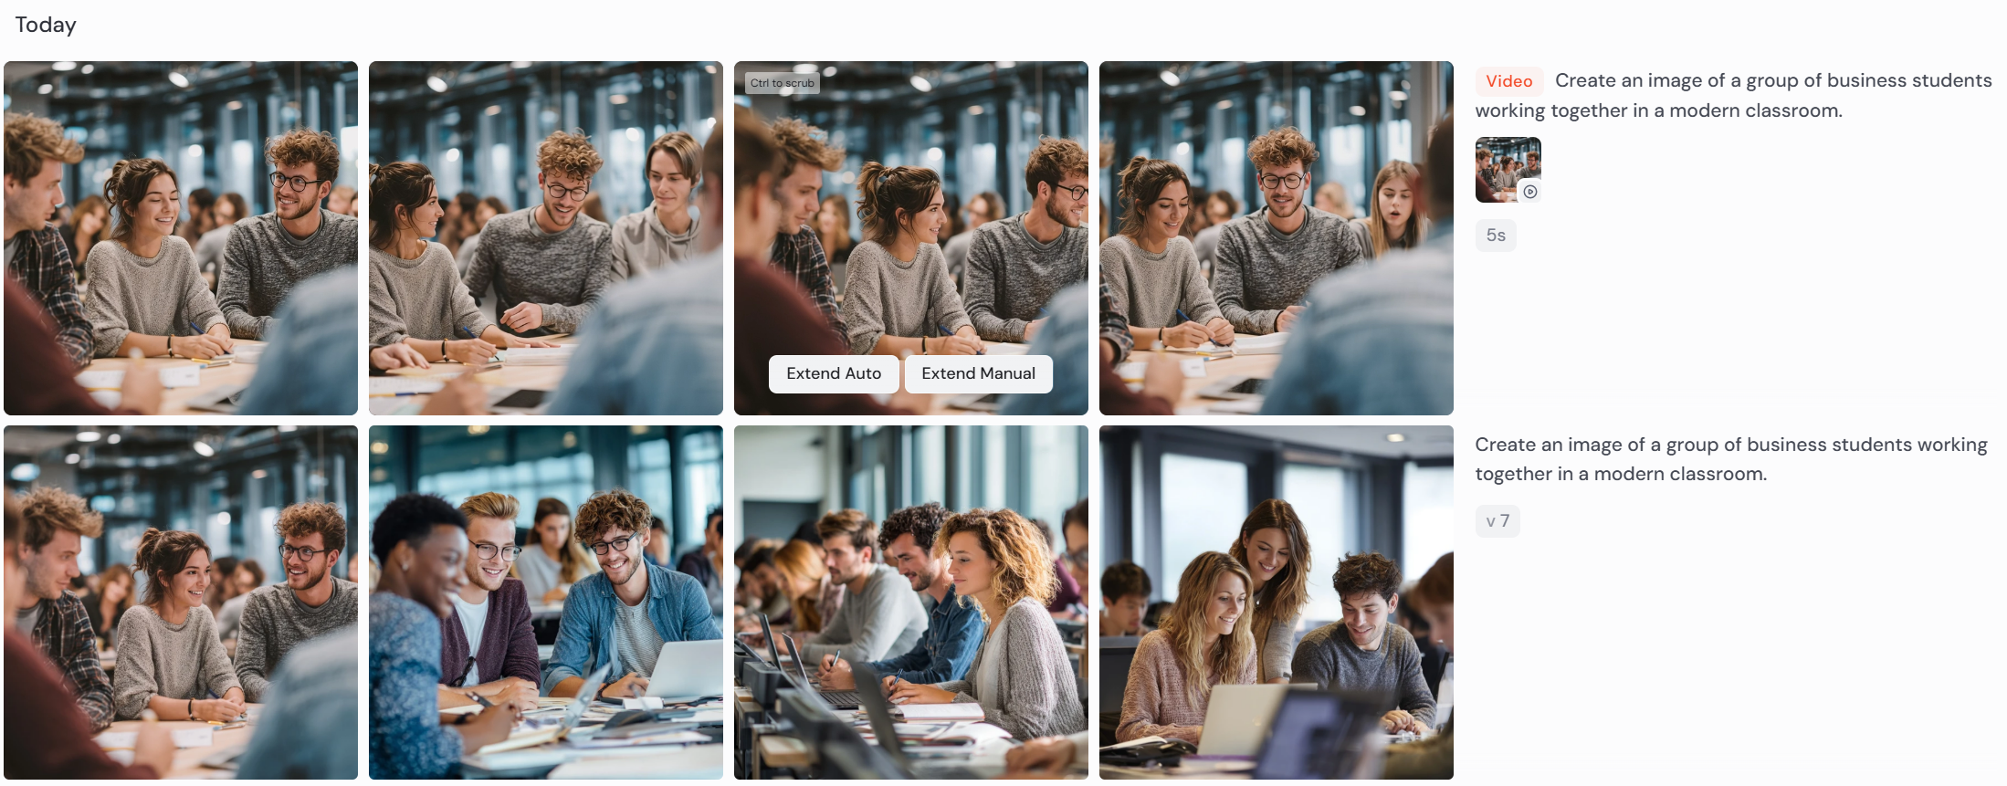
A Demo of image and video generation using Midjourney

Slide 10
Mid journey and its underlying models
A large language model (LLM) and a diffusion model. The LLM interprets and breaks down the user’s text into meaningful concepts and converts them into a numerical vector that guides image creation.
Then, the diffusion model starts with random noise and gradually refines it step-by-step, reversing the noise, to produce detailed and high-quality images.
Midjourney's software is built on custom algorithms trained on massive datasets of images paired with text, enabling it to generate diverse artistic styles ranging from photorealistic to surrealistic visuals

Slide 11
They will use chat GPT or other models to generate a prompt and store in text file
Illustrate an MBA student reading a business book in a library.
Picture a business negotiation between two professionals.
Show online business students attending a virtual class on their computers.
Generate an image of a company celebrating its anniversary with a cake.
Show a person networking at a professional business conference.
Create a balanced work-life image: a businessperson relaxing in a park.
Draw a business team discussing a new product idea.
Illustrate a group of students giving a group presentation in class.
Create an image of a group of business students working together in a modern classroom.
Show a business meeting with people from different countries shaking hands.
Draw a person presenting sales data on a big screen in an office.
Show a leader giving an inspiring speech on a stage.
Illustrate a team brainstorming ideas around a table.
Picture an entrepreneur working on a laptop in a coffee shop.
Generate an image of a diverse business team celebrating success.
Show a smart office with people using laptops and digital screens.

Slide 12
Comparison of prompt generation difference between chatgpt and midjourney
DALL-E 3(Chat gpt)
Craiyon and Midjourney

Slide 13
Comparison of prompt generation difference between chatgpt and midjourney
DALL-E 3(Chat gpt)
Craiyon and Midjourney
Chatgpt and midjourney.

Slide 14
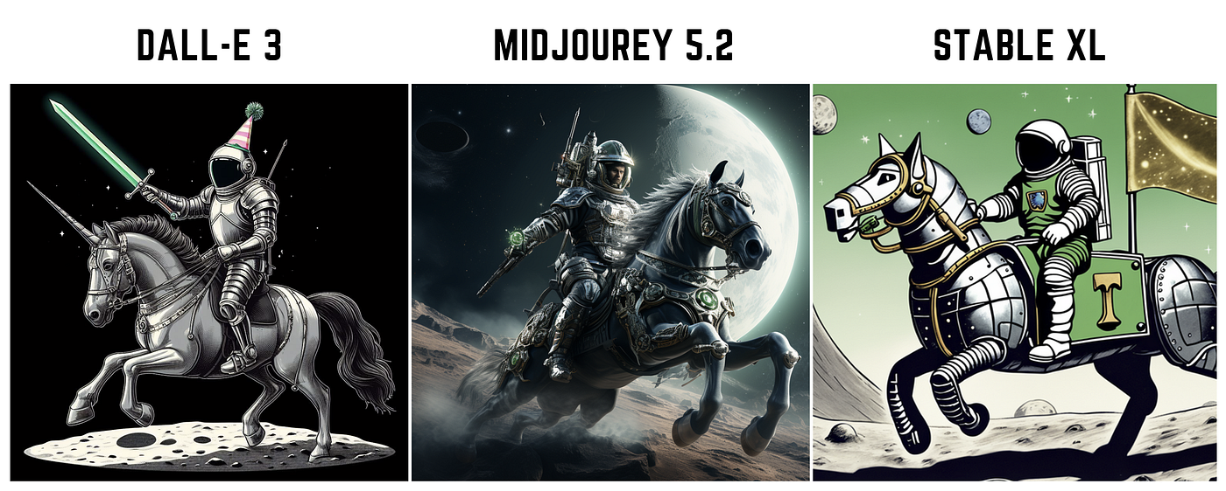

Slide 15
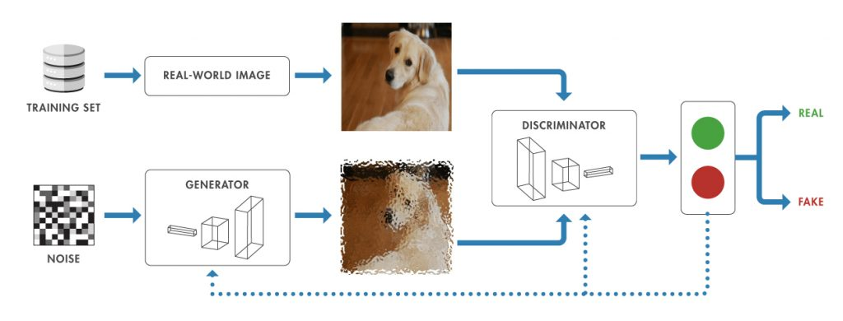
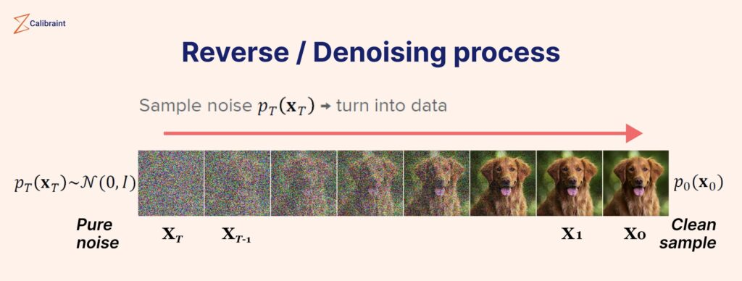
How stable diffusion model works by generating noise

Slide 16
